Slide 1
Natural Language Processing
EXTC – BE(SEM VIII) – NLP
Prof. Priyanka Kadam
Assistant Professor
Dept. of Electronics and Telecommunication
SIES Graduate School of Technology

Slide 2
Bayes Theorem Formula
The formula for the Bayes theorem can be written in a variety of ways. The following is the most common version:
P(A ∣ B) = P(B ∣ A)P(A) / P(B)
P(A ∣ B) is the conditional probability of event A occurring, given that B is true.
P(B ∣ A) is the conditional probability of event B occurring, given that A is true.
P(A) and P(B) are the probabilities of A and B occurring independently of one another.

Slide 3
Example of Bayes Theorem
Problem 1: Three urns contain 6 red, 4 black; 4 red, 6 black, and 5 red, 5 black balls respectively. One of the urns is selected at random and a ball is drawn from it. If the ball drawn is red, find the probability that it is drawn from the first urn.
Solution: Let E1, E2, E3, and A be the events defined as follows:
E1 = urn first is chosen
E2 = urn second is chosen
E3 = urn third is chosen
A = ball drawn is red

Slide 4
Since there are three urns and one of the three urns is chosen at random, therefore:
P(E1) = P(E2) = P(E3) = ⅓
If E1 has already occurred, then urn first has been chosen, containing 6 red and 4 black balls. The probability of drawing a red ball from it is 6/10.
So, P(A/E1) = 6/10
Similarly, you have P(A/E2) = 4/10 and P(A/E3) = 5/10
You are required to find the P(E1/A) i.e., given that the ball drawn is red, what is the probability that it is drawn from the first urn.
By Bayes theorem, you have
P(E1/A) = [P(E1) P(A/E1)]/[P(E1) P(A/E1) + P(E2) P(A/E2) + P(E3) P(A/E3)]
= (1/3 * 6/10) / ((1/3 * 6/10) + (1/3 * 4/10) + (1/3 * 5/10))
= ⅖

Slide 5
Problem 2:
An insurance company insured 2000 scooter drivers, 4000 car drivers, and 6000 truck drivers. The probability of an accident involving a scooter driver, car driver, and a truck is 0.01, 0.03, and 0.015 respectively. One of the insured persons meets with an accident. What is the probability that he is a scooter driver?
Let E1, E2, E3, and A be the events defined as follows:
E1 = person chosen is a scooter driver
E2 = person chosen is a car driver
E3 = person chosen is a truck driver and
A = person meets with an accident

Slide 6
Since there are 12000 people, therefore:
P(E1) = 2000/12000 = ⅙
P(E2) = 4000/12000 = ⅓
P(E3) = 6000/12000 = ½
It is given that P(A / E1) = Probability that a person meets with an accident given that he is a scooter driver = 0.01
Similarly, you have P(A / E2) = 0.03 and P(A / E3) = 0.15
You are required to find P(E1 / A), i.e. given that the person meets with an accident, what is the probability that he was a scooter driver?
[P(E1/A) = P(E1) P(A/E1)] / [P(E1) P(A/E1)+P(E2) P(A/E2)+P(E3) P(A/E3)]
= (1/6 * 0.01)/[(1/6 * 0.01) + (1/3 * 0.03) + (1/2 * 0.15)]
= 1/52

Slide 7
Problem 3:
A man is known to speak the truth 2 out of 3 times. He throws a die and reports that the number obtained is a four. Find the probability that the number obtained is actually a four.

Slide 8
Let A be the event that the man reports that number four is obtained.
Let E₁ be the event that four is obtained and E₂ be its complementary event.
Then, P(E₁) = Probability that four occurs = 1/6.
P(E₂) = Probability that four does not occur = 1- P(E₁) = 1 – (1/6) = 5/6.
Also, P(A|E₁)= Probability that man reports four and it is actually a four = 2/3
P(A|E₂) = Probability that man reports four and it is not a four = 1/3.
By using Bayes’ theorem, probability that number obtained is actually a four, P(E₁|A)

Slide 9
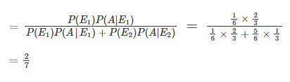

Slide 10
Problem 4:
Three persons A, B and C have applied for a job in a private company. The chance of their selections is in the ratio 1 : 2 : 4. The probabilities that A, B and C can introduce changes to improve the profits of the company are 0.8, 0.5 and 0.3, respectively. If the change does not take place, find the probability that it is due to the appointment of C.

Slide 11
Let E₁: person A get selected
E₂: person B get selected
E₃: person C get selected
A: Changes introduced but profit not happened
Now, P(E₁) = 1/(1+2+4) = 1/7
P(E₂) = 2/7 and P(E₃) = 4/7
P(A|E₁) = P(Profit not happened by the changes introduces by A) = 1 – P(Profit happened by the changes introduces by A) = 1 – 0.8 = 0.2
P(A|E₂) = P(Profit not happened by the changes introduces by B) = 1 – P(Profit happened by the changes introduces by B) = 1 – 0.5 = 0.5
P(A|E₃) = P(Profit not happened by the changes introduces by C) = 1 – P(Profit happened by the changes introduces by C) = 1 – 0.3 = 0.7

Slide 12
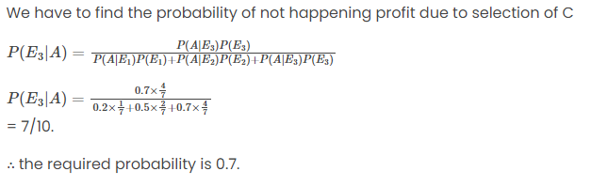

Slide 13
It is observed that 50% of mails are spam. There is a software that filters spam mail before reaching the inbox. It accuracy for detecting a spam mail is 99% and chances of tagging a non-spam mail as spam mail is 5%. If a certain mail is tagged as spam find the probability that it is not a spam mail.

Slide 14
Let E₁ = event of spam mail
E₂ = event of non-spam mail
A = event of detecting a spam mail
Now, P(E₁) = 0.5 and P(E₂) = 0.5
P(A|E₁) = 0.99 and P(A|E₂) = 0.05

Slide 15
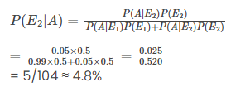

Slide 16
An unbiased dice is rolled and for each number on the dice a bag is chosen:
Bag A contains 3 white ball and 2 black ball, bag B contains 3 white ball and 4 black ball and bag C contains 4 white ball and 5 black ball. Dice is rolled and bag is chosen,
if a white ball is chosen find the probability that it is chosen from bag B.
Numbers on the Dice | Bag choosen
1 | Bag A
2 or 3 | Bag B
4 or 5 or 6 | Bag C

Slide 17
Let E₁ = event of choosing bag A
E₂ = event of choosing bag B
E₃ = event of choosing bag C
A = event of choosing white ball
Then, P(E₁) = ⅙, P(E₂) = 2/6 = ⅔, P(E₃) = 3/6 = ½
And P(A|E₁) = ⅗, P(A|E₂) = 3/7, P(A|E₃) = 4/9

Slide 18
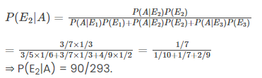

Slide 19
Problem 5:
A card is lost from a pack of 52 cards. From the remaining cards two are drawn randomly and found to be both clubs. Find the probability that the lost card is also a clubs.

Slide 20
Let E₁ = Lost card is a club
E₂ = lost card is not a club
A = both drawn cards are clubs
P(E₁) = 13/52 = ¼ P(E₂) = 39/52 = ¾
P(A|E₁) = P(drawing both club cards when the lost card is a club) = 12/51 × 11/50
P(A|E₂) = P(drawing both club cards when the lost card is not a club) = 13/51 × 12/50

Slide 21
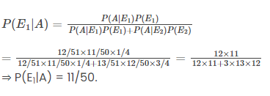

Slide 22
Random Variables
Find the variance and standard deviation of the following scores on an exam: 92, 95, 85, 80, 75, 50
SOLUTION First we find the mean of the data:
Mean = 92+95+85+80+75+50 /6
= 477 6
= 79.5

Slide 23
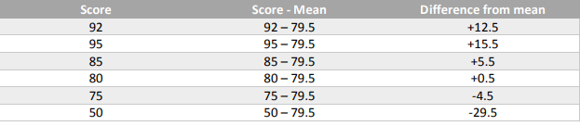
Then we find the difference between each score and the mean (deviation).

Slide 24
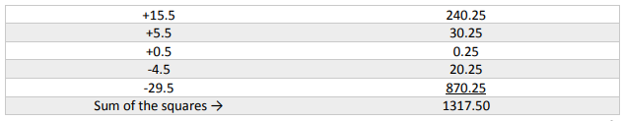
Next we square each of these differences and then sum them.

Slide 25
The sum of the squares is 1317.50.
Next, we find the “mean” of this sum (the variance).
=1317.50/ 5
= 263.5
Finally, we find the square root of this variance.
=√263.5
≈ 16.2
So, the standard deviation of the scores is 16.2
the variance is 263.5

Slide 26
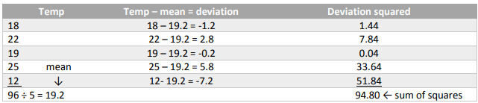
Find the standard deviation of the average temperatures recorded over a five-day period last winter: 18, 22, 19, 25, 12

Slide 27
To find the variance, we divide 5 – 1 = 4.
=94.8 /4
= 23.7
Finally, we find the square root of this variance.
√23.7 ≈ 4.9
So the standard deviation for the temperatures recorded is 4.9;
the variance is 23.7.

Slide 28
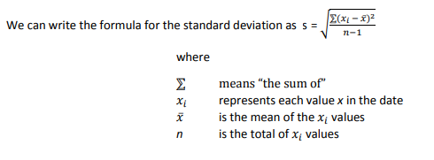

Slide 29
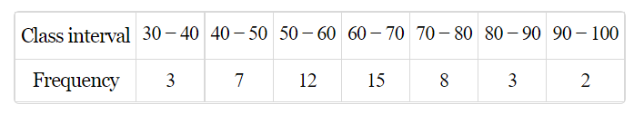
Calculate the mean, variance and standard deviation for the following distribution :

Slide 30
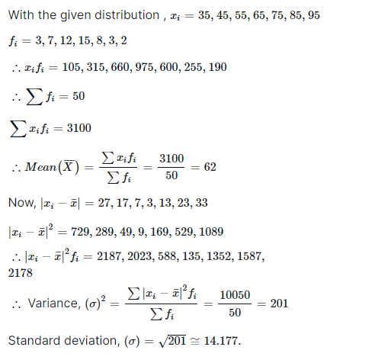

Slide 32
Thank You!
(priyankak@sies.edu.in)

Slide 33
https://www.tutorialspoint.com/natural_language_processing/natural_language_processing_quick_guide.htm
Colab Implement:
https://colab.research.google.com/drive/1eAipYEBJK3zWLF5T8xDFT2iLtwEM8Olf?authuser=1#scrollTo=ihuTtwAnoTof

